Slide 2
Introduction of Power BI
Power BI is one of the most popular Data Visualization and Business Intelligence tool. The Power BI tool is the collection of apps, data connectors, and software services which are used to get the data from different data sources, transforms data, and produces useful reports.
Power BI was designed by the West Chadic George in 2010.
In September 2014, Microsoft revealed the first preview to Power BI.
The first version of Power BI is released on 24 July 2015. It was based on Excel-based Add-ins such as Pivot, view, Power Query, and Map.
What is Power BI ?
Power BI is a Data Visualization, and Business Intelligence tool which helps to convert data from different data sources into interactive dashboards and BI reports. It provides interactive visualizations with self-service business intelligence capabilities where end users can create reports and dashboards by themselves, without having to depend on information technology staff or database administrators.

Slide 3
Why we use Power BI
Here are some significant reasons to use the Power BI tool:
It allows real-time dashboard updates.
It provides secure and reliable connections to the data sources in the cloud.
It allows data exploration using a natural language query.
Power BI provides a hybrid configuration, quick deployment, and secure environment.
It provides features for dashboard visualization regularly updated with the community.
It provides pre-built dashboards and reports for SaaS solutions.

Slide 4
Importance of BI
Business intelligence is used to improve all parts of a company by improving access to the firm's data and then using that data to increase profitability. Companies that practices BI can translate their collected data into insights their business processors.
Then the insights can be used to create strategic business decisions that improve productivity and accelerate the growth.
Some more potential benefits of business intelligence tools include:
Driving new revenues.
It increases operational efficiency.
It optimizes internal business processes.
It improves decision making.
It is gaining a competitive advantage over business rivals.
It is used in spotting business problems that need to be addressed.
It can be used in assisting companies in the identification of market trends.

Slide 5
Power BI Advantages
Here are some advantages of Power BI, as shown below:
1. Secure Report Publishing: You can automate setup data refresh and publish reports that allowing all the users to avail the latest information.
2. No Memory and Speed Constraints: To Shift an existing BI system into a powerful cloud environment with Power BI embedded eliminates memory. Speed constraints ensure that data is quickly retrievable and analyzed.
3. No Specialized Technical Support required: The Power BI provides quick inquiry and analysis without the need for specialized technical support. It also supports a powerful natural language interface and the use of intuitive graphical designer tools.
4. Simple to Use: Power BI is simple to use. Users can easily find it only on behalf of a short learning curve.
5. Constant innovation: The Power BI product is updated in every month with new functions and features.
6. Rich, personalized dashboard: The crowning feature of Power BI is the information dashboards that can be customized to meet the exact need of any enterprise. You can easily embed the dashboards, and BI reports in the applications to provide a unified user experience.

Slide 6
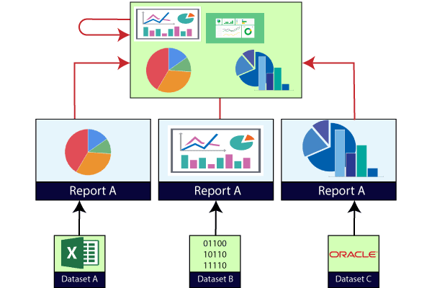
Power BI Dashboard
Power BI dashboard is a single page, also called a canvas that uses visualization to tell the story. It is limited to one page; therefore, a well-designed dashboard contains only the most essential elements of that story.
The visualizations visible on the dashboard are known as tiles. These tiles are pinned to the dashboard from reports. The visualizations on a dashboard come from reports, and each report is based on one data set.
A dashboard can combine on-premises and cloud-born data. And they are providing a consolidated view regardless of where the data lies.

Slide 7
Power BI Reports
A Power BI report is a multi-perspective view into the dataset, with visualizations which represent different findings and insights from that dataset.
A report can have a single visualization or multiple visualizations. The visualizations in a report represent something like a dashboard does but serve a different purpose.
These visualizations are not static. These are highly interactive & highly customizable visualizations which update, as the underlying data changes. You can add and remove the data, change visualization types, and apply filters in your model to discover insights.

Slide 8
Power BI Data Sources
Power BI Desktop and Power BI Services support a large range of data sources. Click on the Get Data button,
and it shows you all the available data connections. You can connect to different Flat files, Azure cloud, SQL database,
and Web platforms, also such as Google Analytics, Facebook, and Salesforce objects. It includes an ODBC connection
to connect to other ODBC data sources.

Slide 9
Here are the available data sources in Power BI, as shown below:
SQL Database
Flat Files
Blank Query
OData Feed
Azure Cloud Platform
Online Services
Oracle database
IBM Db2 database
IBM Netezza
IBM Informix database (Beta)
Other data sources such as Exchange, Hadoop, or active directory

Slide 10
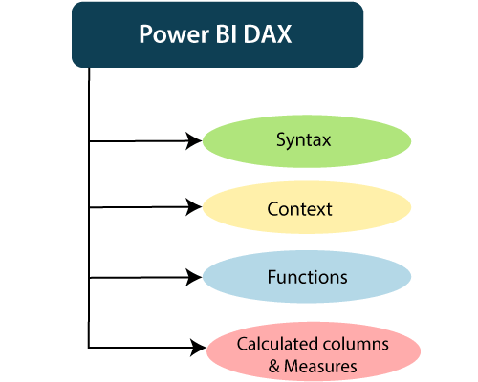
Power BI DAX
DAX (Data Analysis Expressions) is a formula expression language. It can be used in different BI and visualization tools. DAX is also known as function language in which the full code is kept inside a function. DAX programming formula contains two data types such as Numeric and Other.
Numeric includes currency, integers, and decimals, where Other includes string and a binary object.

Slide 11
How does it work?
For understanding the Power BI DAX, it has main three fundamental concepts such as:
Syntax
Context
Functions

